Slide 1


www
Images preparation
for
Computer Vision
Prepared by:
Sarada Lee
Perth Machine Learning Group

Slide 2
Agenda
CV - Supervised Learning and its Pros/Cons
Classification
Classification + Localization
Object Detection
Instance Segmentation
CV – Semi-supervised Learning its Pros/Cons
Labelling Tips
Live Demo for labelling tools
Notes:
Add multi-class classification example

Slide 3
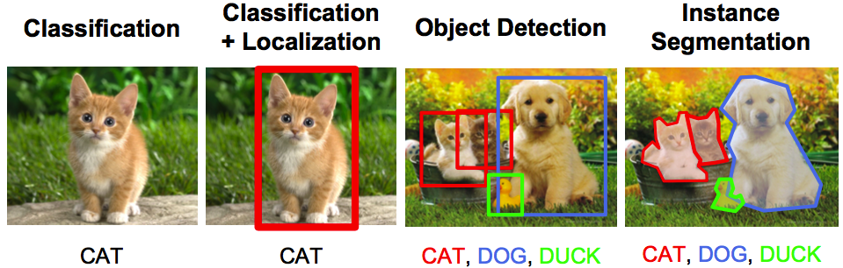
Computer Vision – Supervised Learning Tasks vs Labels
Source: http://web.stanford.edu/class/cs224n/
Notes:
Add multi-class classification example

Slide 4
Application for Cystic Fibrosis

Slide 5
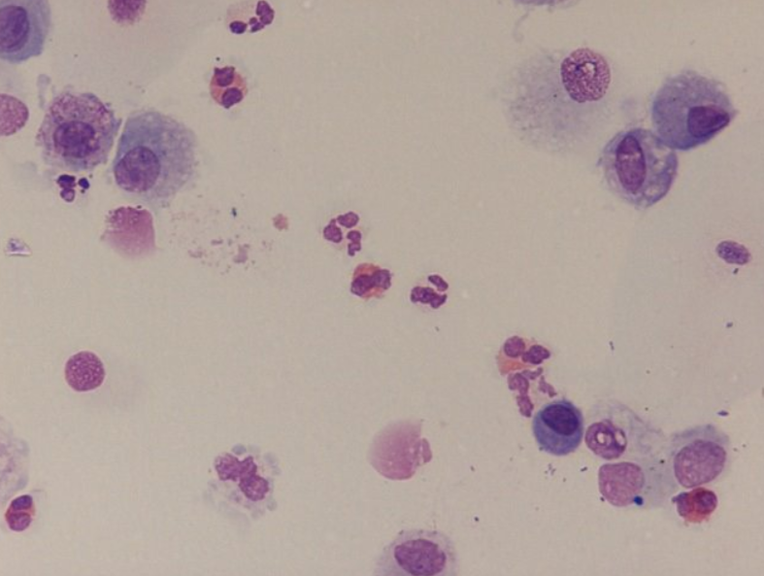
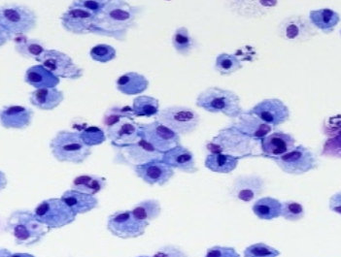
CF – Classification Example 1
Single-label Classification – Binary Classification
Sample
Eosinophils
No Eosinophil
Sources: http://resizeme.club/picresize-164_142164.html
Notes:
Add multi-class classification example

Slide 6
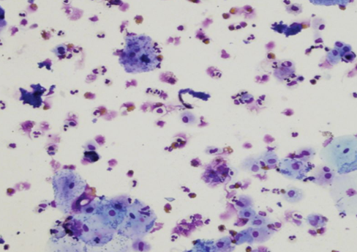
CF – Classification Example 2
Single-label Classification – Multi-classes Classification
Sample
Sample
Eosinophils
No Eosinophil
Cell X
Sources:
http://resizeme.club/picresize-164_142164.html
http://resizeme.club/picresize-164_153164.html
Notes:
Add multi-class classification example

Slide 7
CF – Classification Example 3
Multi-labels Classification
Eosinophils, Cell Y, Cell Z, ……
Notes:
Add multi-class classification example

Slide 8
CF – Classification
Pros:
Quick to implement
Good for screening process
Cons:
Can’t locate the area of interest
Images requirements:
Ideally, provide similar number of images for each class
Annotation:
Single-label classification – csv file or in folders
Multi-labels classification - csv file and in folders
Notes:
Add multi-class classification example

Slide 9
Computer Vision – Supervised Learning Tasks vs Labels
Source: http://web.stanford.edu/class/cs224n/
Notes:
Add multi-class classification example

Slide 10
CF – Classification + Localization
Annotation:
- Bounding box which is the box with the smallest measure (area for 2D image) within which all the points lie.
Pros:
Able to count the number of eosinophils for each image
Cons:
- Impractical to crop image for each cell
Eosinophils
Notes:
Add multi-class classification example

Slide 11
Computer Vision – Supervised Learning Tasks vs Labels
Source: http://web.stanford.edu/class/cs224n/
Notes:
Add multi-class classification example

Slide 12
CF – Object Detection
Annotation:
Bounding box
Pros:
Able to count the number of eosinophils and other cell types for each image
Detect multiple objects
Cons:
Ease to overlook clustered objects
Slow to train
Eosinophils
Cell N
Notes:
Add multi-class classification example

Slide 13
Computer Vision – Supervised Learning Tasks vs Labels
Source: http://web.stanford.edu/class/cs224n/
Notes:
Add multi-class classification example

Slide 14
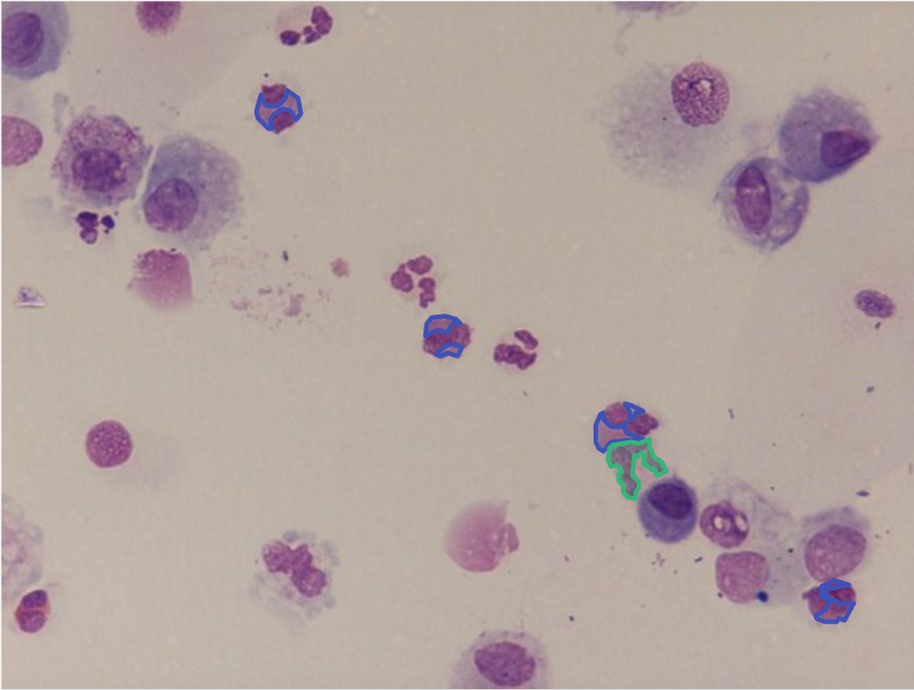
CF – Instance Segmentation
Annotation:
Trace outline for all the interested cells
Count each cell type
Pros:
Predication at pixel level
Quick to implement
Proven success in biomedical
Cons:
Time-consuming on labelling
https://arxiv.org/abs/1505.04597
Eosinophils [4]
Cell N [1]
Notes:
Add multi-class classification example

Slide 15

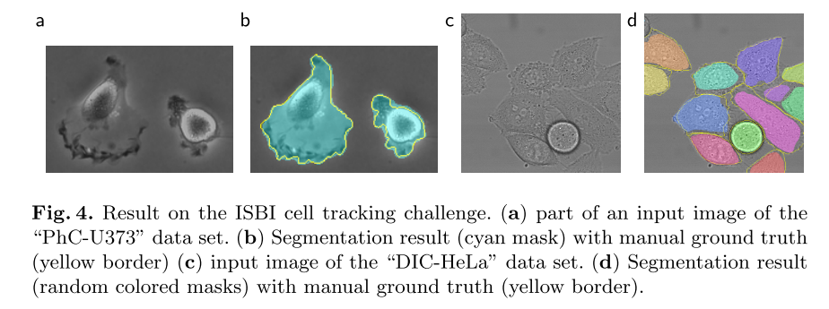
Extracted from: https://arxiv.org/abs/1505.04597
Notes:
Add multi-class classification example

Slide 16
Labelling Considerations
How much “details” you want computer to see?
For supervised learning, annotate images by stage (Agile approach)
May require annotation all over again for different method(s) for ensembling models
For semi-supervised learning, domain knowledge input is essential
No. of labelled data required is highly correlated (at explanatory rate) to the accuracy threshold required.
Notes:
Add multi-class classification example

Slide 17

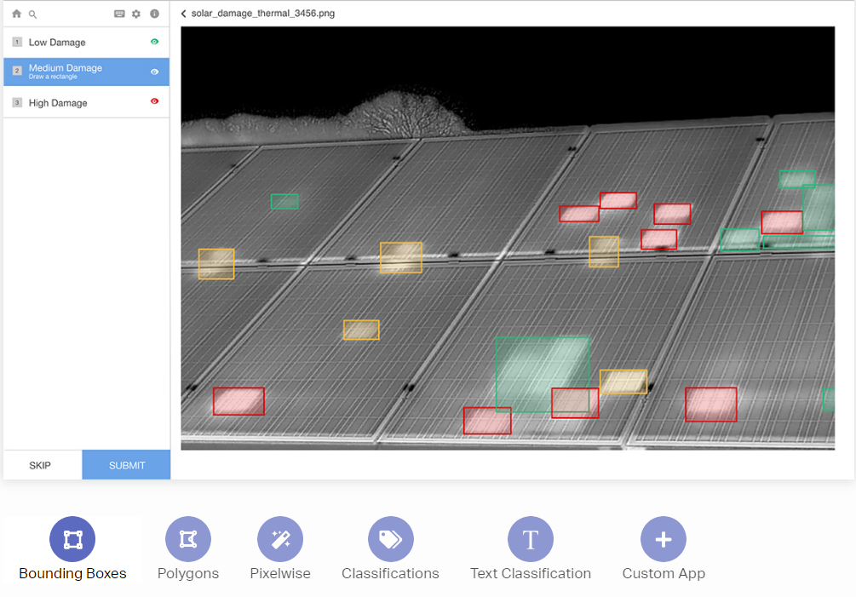
Tools – Supervised Learning

Slide 18
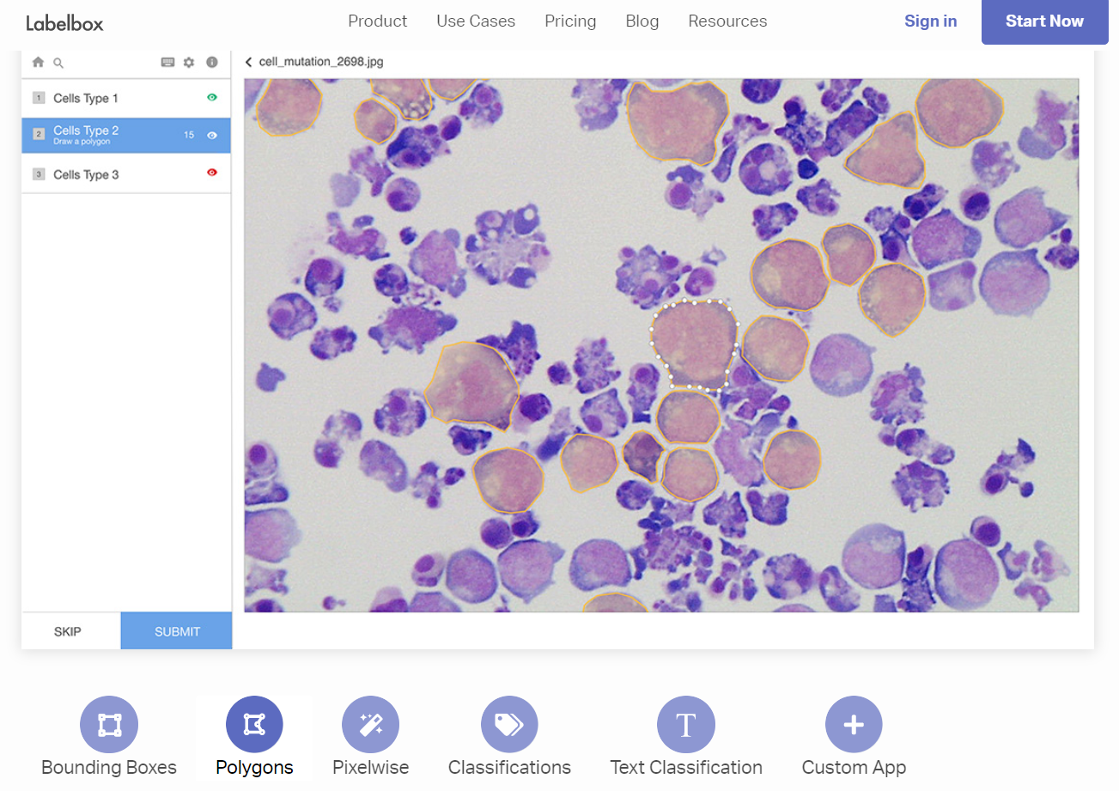
Tools – Supervised Learning

Slide 19
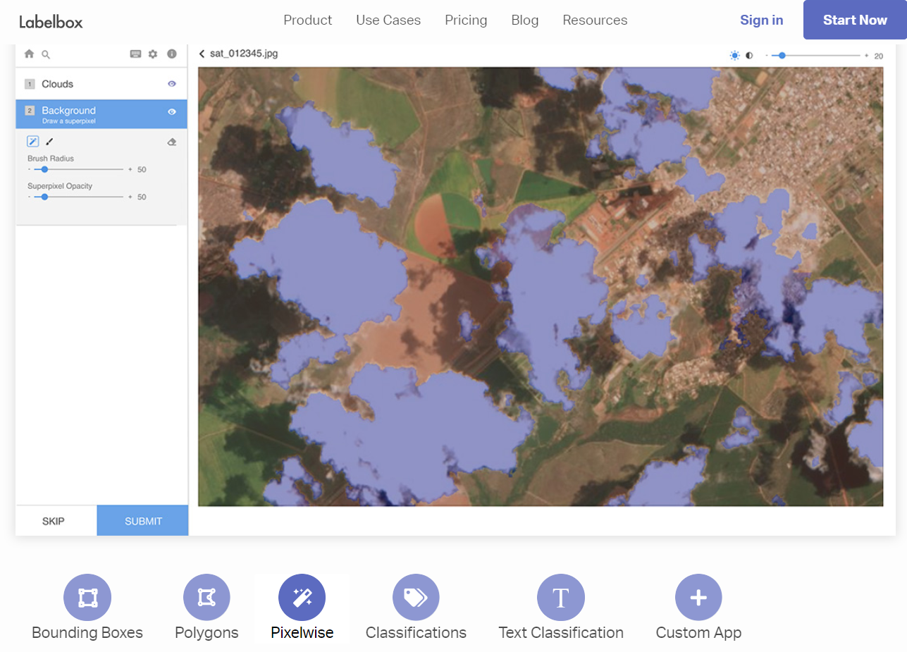
Tools – Supervised Learning

Slide 20
Live Demos

Slide 21
Labelling Tips
Identify the types and then annotate all types (by stage)
Garbage-in-garbage-out - If doubt, “skip” labelling and ask for help later
Consistency in labelling is important
Use real-world data (~ lighting & resolution) not best case data
Notes:
Add multi-class classification example

Slide 22
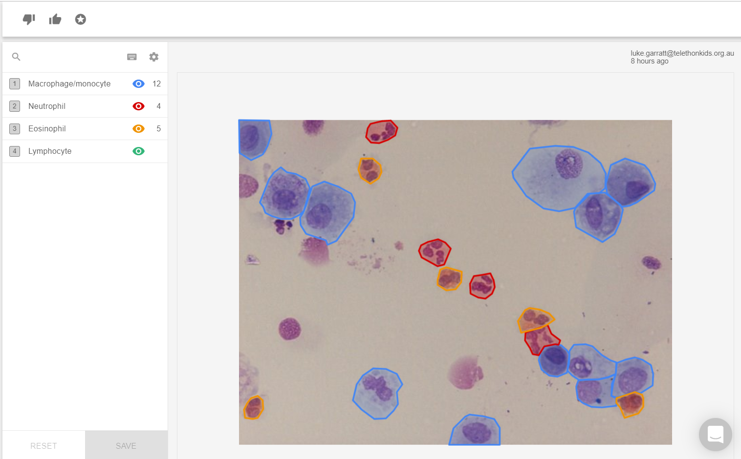
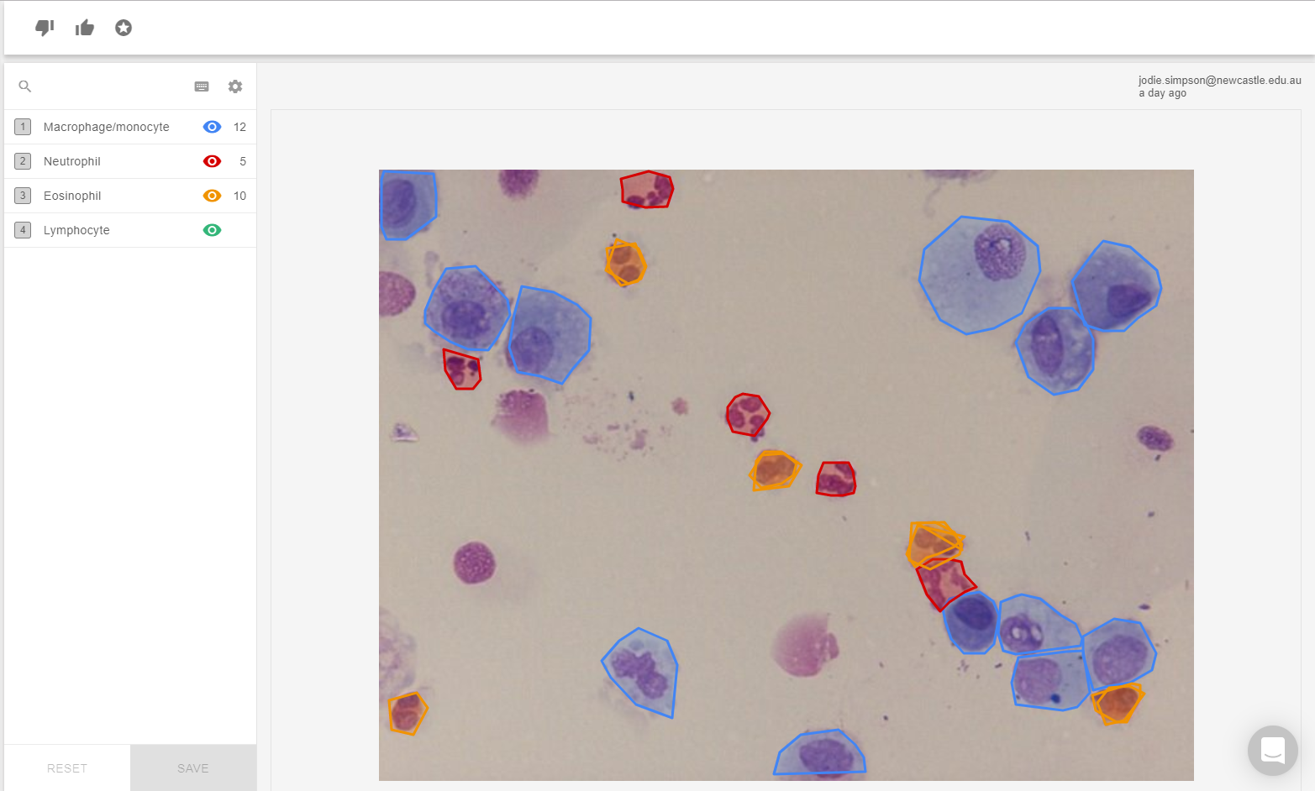
Labelling consistency
Notes:
Add multi-class classification example

Slide 23
Computer Vision – Semi-supervised Learning
Use dimensionality reduction techniques to cluster similar images.
Pros:
Quick to setup and use (can fail fast as well!)
Potentially, request new feature(s)
Cons:
Free version doesn’t provide all predictions and model weight
Not good at fine details at the moment
Annotation:
Ideally, 150-200 CORRECT labels per class for a large dataset
Requires domain knowledge in the labelling process
Notes:
Add multi-class classification example

Slide 24

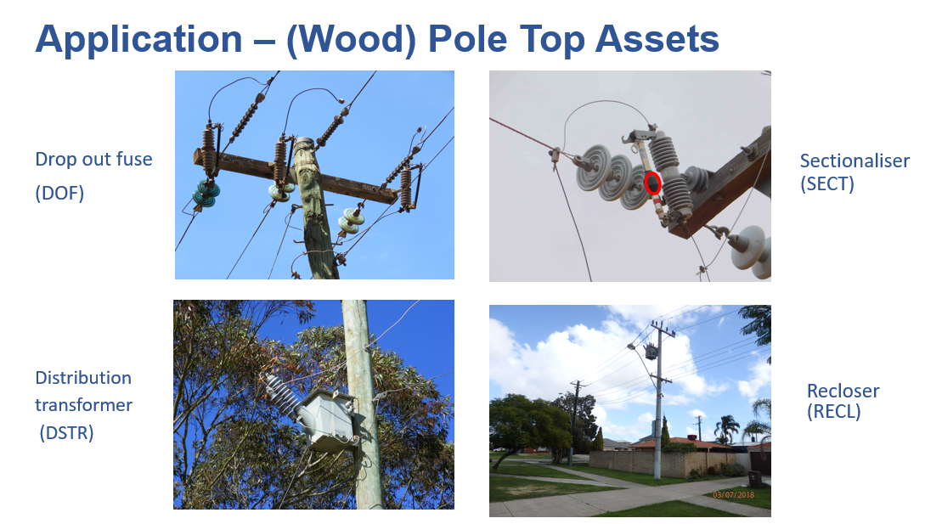
Tools – Unsupervised Learning

Slide 25
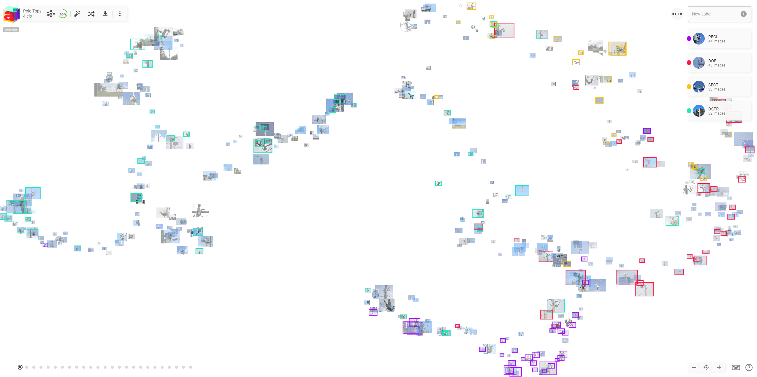
Tools – Unsupervised Learning

Slide 26
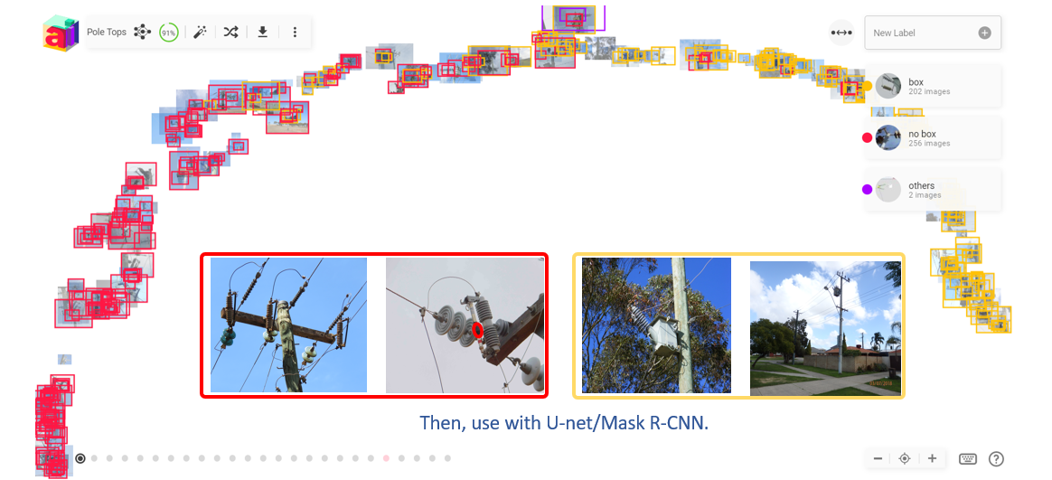
Tools – Unsupervised Learning

Slide 27
Live Demos

Slide 28

Contact: leesarada@gmail.com LinkedIn: Sarada Lee (李文華) GAICD

